Slide 1
DATA SCIENCE SALARY ANALYSIS
Alisha Souza

Slide 2
GOAL
To hire a top talent full time Data Scientist while providing a competitive salary
Small company but expanding rapidly
Possibility of needing a full Data Science team in the future

Slide 3
THE DATA
Utilized a data set that looked at:
Full Time Data Scientists
Experience Levels
Small, Midsize & Large Companies
Data Scientists that worked in the U.S. & Data Scientists out of the U.S.
Data Scientist that worked 100% remote, 50% remote & fully on site

Slide 4
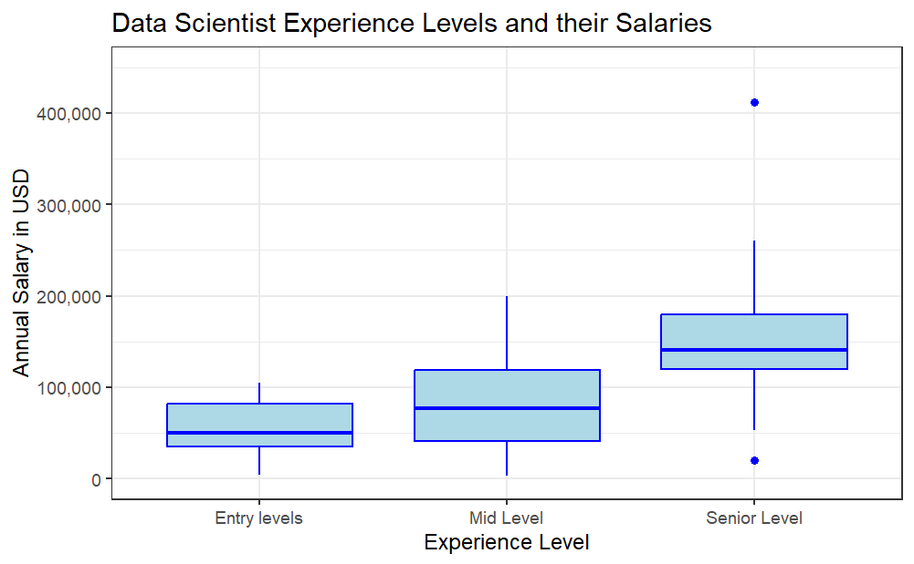
Average Entry Level Salary
54,780
Average Mid Level Salary
$81,734
Average Senior Level Salary
$152,971

Slide 5
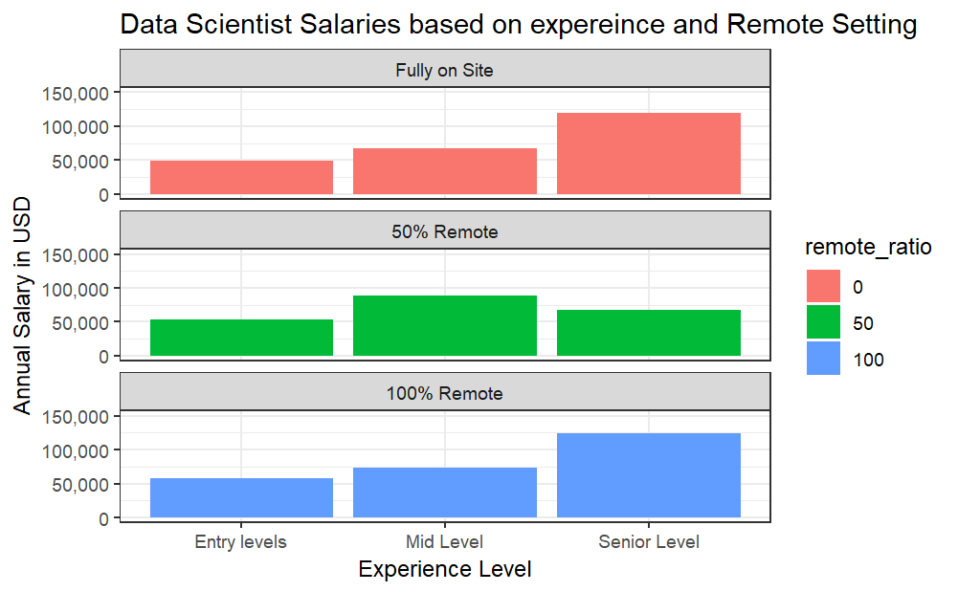
Average Fully on Site Salary
99,520
Average 50% remote Salary
$75,692
Average 100% Remote Salary
$123,422

Slide 6
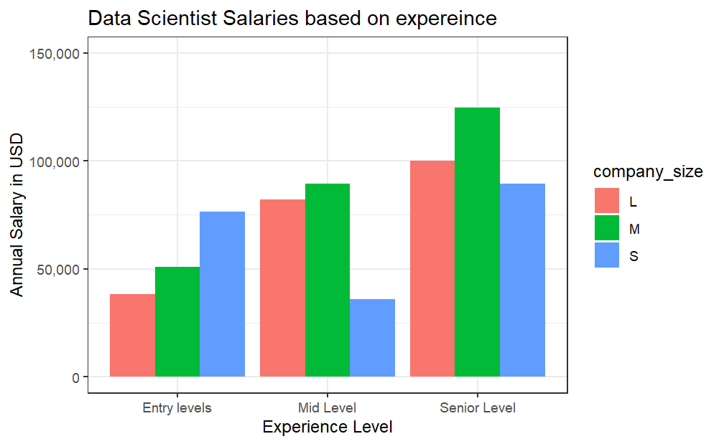
Average Small Company Salary (inc. all experience levels)
53,438
*note lower salary for mid level experienced Data Scientist for Small Company
Average Medium Company Salary (inc. all experience levels)
$127,084
Average Large Company Salary (inc. all experience levels)
$103,313

Slide 7
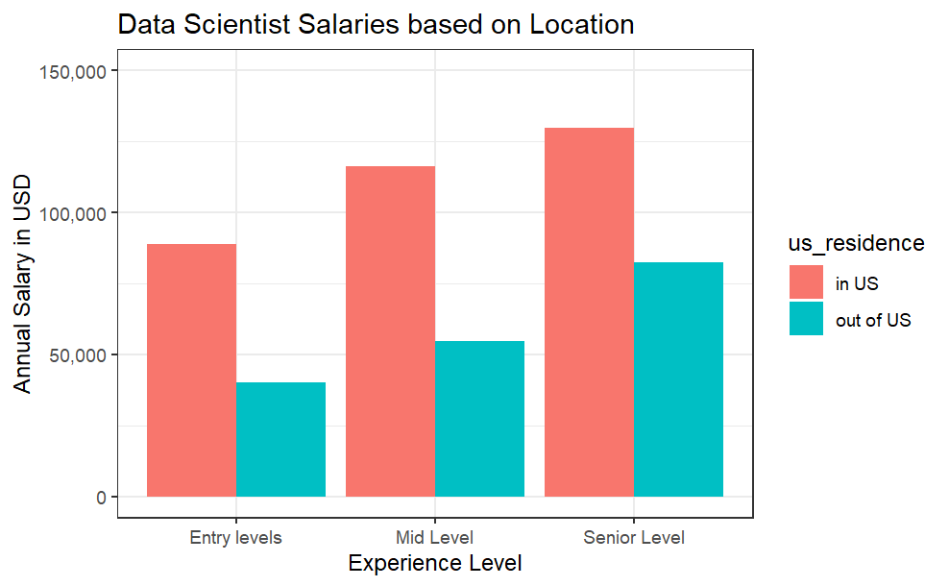
Average Salary of Data Scientists in the U.S.
$149,408
Average Salary of Data Scientists out of the U.S.
$57,989

Slide 8
Conclusions
Overall, as experience level as a Data Scientist increases so does salary
Value of compensation is seen in 50% remote work positions
Data Scientists in the U.S. have higher salaries then out of U.S. Data Scientists
Much lover average salary in Data Scientist that work for small companies
However Mid Level Experience Data Scientists are paid less then entry level data scientists
Competitive Mid Level Data Science Salary for a Small Company (50% remote in U.S.)
$53,438-$81,734

